Slide 3
Employer name
Organization Name
Date
Notes:
Customization Notes:
Replace “Employer Name” with the employer you will be meeting with.
Insert:
Employer’s logo and name
Your organization’s name
Presentation date.

Slide 4
Organization
Notes:
Customization Notes: Fill in each of the text boxes based on the prompts in the boxes.

Slide 5
Notes:
Speaker Notes: You’re likely familiar with diabetes within your workforce. But did you know that the onset of type 2 diabetes can be slowed and even prevented? On this slide, you can see a good breakdown of what the continuum of diabetes prevention and management looks like.
Today, we will briefly talk about diabetes and then we will focus on that first piece of the continuum—the importance of type 2 diabetes prevention and how you can give your workforce with the tools to live longer, happier, and healthier lives.
Note to Speaker: This information is also available on the Healm platform as a handout for employers.

Slide 6
Notes:
Speaker Notes: Prevention is key, and there is a lot to consider. That’s why we are excited to introduce you to how HealmAtWork.org can support you through all the decisions and considerations needed to establish a successful diabetes prevention program. We’ll talk much more about Healm as we move through our topics today.

Slide 7
Notes:
Speaker Notes: Type 2 diabetes is one of the greatest health risks Americans face today. The proportion of the U.S. workforce dealing with the effects of this condition is growing. Let’s explore a little more about how diabetes could affect your organization.

Slide 8
Notes:
Speaker Notes: Diabetes is a chronic health condition that affects how the body turns food into energy. You’ve probably heard these statistics before and understand how prevalent diabetes is in the United States and within your own workforce. What we don’t always talk as much about is that 1 in 5 people who have diabetes don’t know it.
Discussion Question: When you think about 1 in 10 people on average having diabetes, do you think this is reflective of what you know about the health of your employees?
Source: www.cdc.gov/diabetes/communication-resources/index.html

Slide 9
State/County/City
Notes:
Customization Notes:
Consider adding state-, county-, or city-specific data about diabetes prevalence, cost, and impact.
Highlight any large successes or specific impact that would be relevant to the employer(s) based on their employee characteristics

Slide 10
Notes:
Speaker Notes: The American Diabetes Association estimates that diagnosed diabetes cost the United States $412.9 billion in 2022. Of that total, $306.6 billion of is attributed to direct medical costs. The other $106.3 billion is attributed to indirect costs, like increased absence from work, reduced productivity while at work, and inability to work due to diabetes-related disability.
People with diabetes spend about 2.6 times more on medical expenses than people without diabetes.
Discussion Questions:
Have you seen this level of cost increase for medical expenses in your employees diagnosed with diabetes?
Do you have the data you need to identify these costs?
Considering the high financial cost of diabetes, it’s understandable that so many people are working to prevent the onset of type 2 diabetes.
Source: https://diabetesjournals.org/care/article/47/1/26/153797/Economic-Costs-of-Diabetes-in-the-U-S-in-2022

Slide 11
Notes:
Speaker Notes: From 2017 to 2022, the direct medical cost of diabetes increased by 7%, after adjusting for inflation.
National healthcare costs attributable to diabetes have increased by $80 billion in the past 10 years—from $227 billion in 2012 to $307 billion in 2022. What kind of increases will we see by 2029 if we don’t focus enough on prevention?
Source: https://diabetes.org/newsroom/press-releases/new-american-diabetes-association-report-finds-annual-costs-diabetes-be

Slide 12
Notes:
Speaker Notes: You likely have a pretty good understanding of how prevalent diabetes is within your workforce and understand what a driver of cost this can be. You also probably understand that diabetes can drive up your organization’s healthcare costs. What you may not know is how many people have prediabetes.
In early 2020, CDC released new data that show that 38.4 million Americans have diabetes, and another 97.6 million Americans have prediabetes.
CDC is working to reverse the diabetes epidemic by helping identify people with prediabetes, prevent type 2 diabetes and diabetes complications, and improve the health of all people with diabetes.
As part of their efforts, the National Diabetes Prevention Program (National DPP) provides the framework for type 2 diabetes prevention efforts in the United States. Through the National DPP’s evidence-based, affordable lifestyle change program, adults with prediabetes learn to make healthy changes that can cut their risk of type 2 diabetes by as much as 58% (71% for those over 60).
More than 1,500 CDC-recognized organizations offer the National DPP lifestyle change program, and more than 400,000 eligible people have participated. About 40 commercial health plans provide some coverage for the program, and Medicare began reimbursing for CDC-recognized in-person programs in 2018.

Slide 13
Notes:
Speaker Notes: Prediabetes is a serious health condition where blood sugar levels are higher than normal, but not high enough to be diagnosed as type 2 diabetes. 97.6 million U.S. adults—more than 1 in 3—have prediabetes. Of those with prediabetes, more than 80% don’t know they have it.
Source: https://www.cdc.gov/diabetes/hcp/lifestyle-change-program/index.html

Slide 14
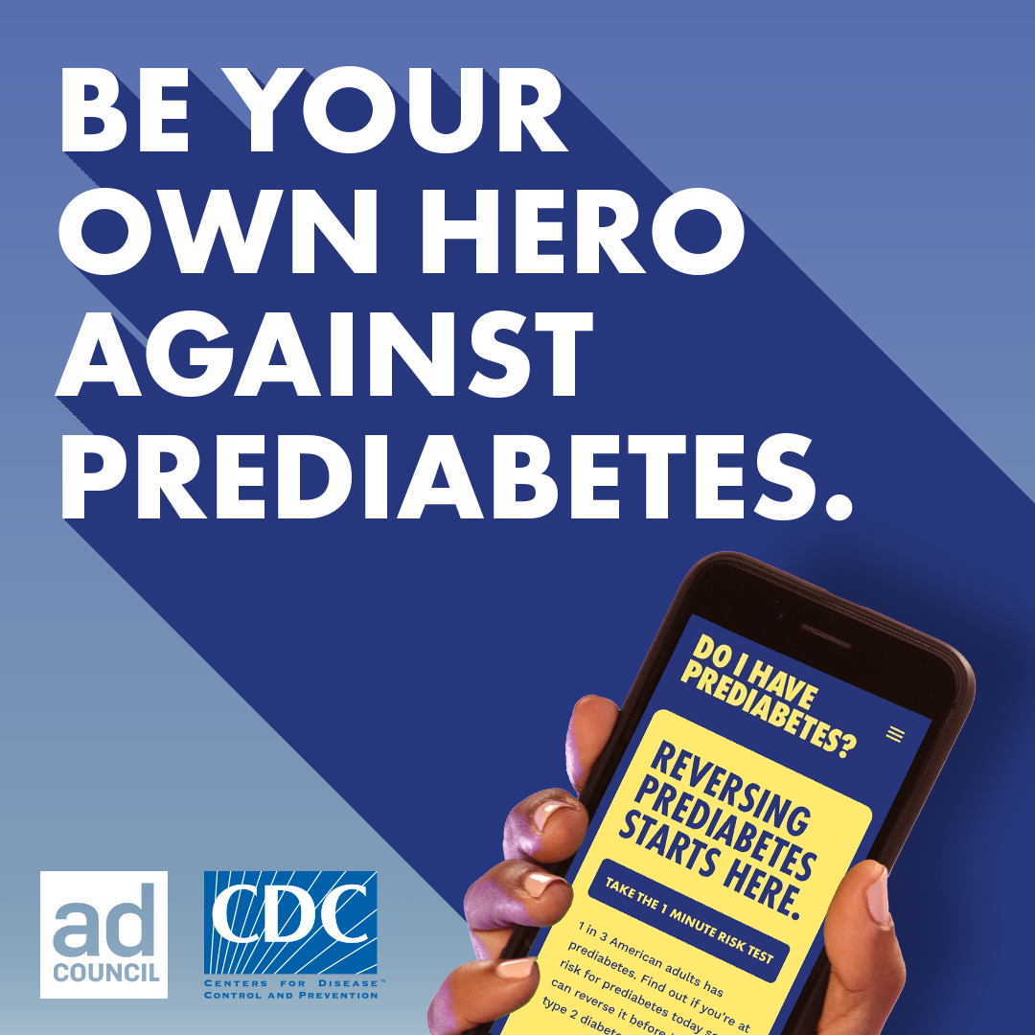
Notes:
Note to Speaker: The current Ad Council campaign video can be launched directly within the presentation. Be sure you have Internet access when presenting. If you don’t, you will need to remove this slide.
Speaker Notes: There is no cure for diabetes once a person has experienced the onset. The good news is that we know that evidence-based interventions can prevent or delay the onset of diabetes. If a person has prediabetes, they can make lifestyle changes to prevent or delay type 2 diabetes and other serious health problems.
It may seem overwhelming to think about identifying who in your employee population has prediabetes or is at risk. But the Prediabetes Risk Test is an easy self-assessment that doesn’t take long to complete—and it provides an answer right away!
We’ve seen employers find ways to easily add this short risk test into their existing health risk assessment and screening activities.
Discussion Questions:
Would you like to learn more about how we can help you plan for screening your employees for prediabetes?
Do you have partners who currently help you with employee screenings events, such as health fairs?
Can you integrate the Prediabetes Risk Test into existing employee screening events?
Source: https://doihaveprediabetes.org/

Slide 15
Notes:
Speaker Notes: Type 2 diabetes is one of the greatest health risks Americans face today. The proportion of the U.S. workforce dealing with the effects of this condition is growing. Let’s explore a little more about how the effects of diabetes could affect your organization.

Slide 16
Notes:
Speaker Notes: Imagine being able to reduce the chances of a person developing type 2 diabetes by more than half. That’s what the CDC-recognized National DPP lifestyle change program can do for your workforce.
Studies have shown that adults who joined this program and lost 5% to 7% of their body weight while exercising 150 minutes a week lowered their risk of developing type 2 diabetes by up to 58%. For those over 60, the risk went down by 71%.
The program can also help participants prevent heart attacks and strokes, improve their overall health, boost their energy levels, and even reverse their prediabetes diagnosis.
But that’s not all. The benefits of this program last for years. Even 10 years later, program participants were 33% less likely to develop type 2 diabetes than those who did not join the program.
The CDC-recognized National DPP lifestyle change program can truly help your employees take charge of their health and their future.
Source: www.cdc.gov/diabetes/prevention-type-2/prediabetes-prevent-type-2.html

Slide 17
Notes:
Speaker Notes: The CDC-recognized lifestyle change program is a key component of the National DPP. It has proven to be more effective than certain medications at preventing type 2 diabetes. It uses a CDC-approved, evidence-based curriculum to help participants build new habits, lower their risk of type 2 diabetes, and improve their health.
The National DPP lifestyle change program is led by trained Lifestyle Coaches. Participants attend group classes and receive coaching for 1 year. Only a CDC-recognized organization should deliver the program.
Source: https://www.cdc.gov/diabetes-prevention/lifestyle-change-program/lifestyle-change-program-details.html and https://www.cdc.gov/diabetes-prevention/hcp/lifestyle-change-program/program-details.html

Slide 18
Notes:
Speaker Notes: The National Diabetes Prevention Program (National DPP) is a partnership of public and private organizations working to prevent or delay type 2 diabetes. Partners, like your organization, make it easier for people at risk of type 2 diabetes to participate in an evidence-based lifestyle change program to reduce their risk of type 2 diabetes.
Source: https://www.cdc.gov/diabetes-prevention/programs/what-is-the-national-dpp.html

Slide 19
Notes:
Speaker Notes: Employers that have launched the National DPP lifestyle change program have found much success. These employers are a great resource and example for how to successfully execute a prevention program. The National DPP has several case studies and information from employers to help spark ideas on how to implement your program.

Slide 20
Notes:
Customization Note: If you think the employer would be interested in the details of the lifestyle change program curriculum, use this slide to list FOUR of the topics below that you think would be of the most interest to them:
Get active.
Track activity.
Eat well.
Burn more calories.
Shop and cook.
Cope with triggers.
Heart health.
Get support.
When weight loss stalls.
Speaker Notes: The National DPP lifestyle change program includes a wide variety of curriculum topics that are based on the original 2002 DPP trial and follow-up studies. These are just a few of the 26 topics covered in the curriculum. All CDC-recognized programs will cover at least 22 of the 26 available topics in a 12-month timeframe.
Remember, this is about lifestyle change, which requires a wide variety of topics and support.
Source: https://nationaldppcsc.cdc.gov/s/article/National-DPP-PreventT2-Curricula-and-Handouts

Slide 21
Notes:
Speaker Notes: Putting an effective type 2 diabetes prevention program in place for your workforce is no small undertaking. That’s why we designed the online Healm platform to help you find the best solutions for your organization.
As you navigate Healm, we’ll ask questions and tailor the information to your needs. You’ll see what other employers have done and how they succeeded. And if you want to browse all of the information provided on the platform, you can do that as well.
When you register with Healm, you’ll get access to a team of experts who can support you along the way. They know about the National DPP lifestyle change program, benefits administration, and local resources. You can work with them as much or as little as you want. They’re here to help you whenever you need them.
We know that diabetes prevention works best when it’s part of your workplace culture. Healm will show you how to make this happen. You may be able to start by promoting a benefit that your employee health plan already offers. Or you can take it to the next level by becoming a CDC-recognized organization and offering the National DPP lifestyle change program yourself.
Whatever approach you choose, we’ll help you set realistic goals, measure your progress, and optimize your program over time.

Slide 22
Notes:
Speaker Notes: So how can you help your employees address prediabetes and prevent or delay type 2 diabetes?
Learn more through Healm about how the National DPP lifestyle change program could be a good fit for your organization.
Healm takes you through your journey to covering the program—from considering how to deliver it, to whom to cover, to how to engage those who need to be involved. Healm supports you every step of the way.
Note to Speaker: Provide the link to the Journey to Coverage PDF: https://healmatwork.org/wp-content/uploads/2024/01/Healm-PDF-Journey-to-Coverage.pdf

Slide 23
Notes:
Speaker Notes:
The National DPP lifestyle change program is helping prevent type 2 diabetes across the country. Several of the nation’s most respected companies―including Fortune 100 companies like Costco―have successfully adopted this program.
For more examples, visit the Participating Payers page in the Coverage Toolkit.
We know that many companies want to reduce costs and improve the health of their employees. The National DPP lifestyle change program can help you do both.
Sources:
https://coveragetoolkit.org/participating-payers/;
https://nationaldppcsc.cdc.gov/s/article/Promotional-Materials-for-Employers-and-Insurers

Slide 24
Notes:
Speaker Notes: Type 2 diabetes is one of the greatest health risks Americans face today. The proportion of the U.S. workforce dealing with the effects of this condition is growing. Let’s explore a little more about how diabetes could affect your organization.

Slide 25
Notes:
Customization Notes:
If you decide not to go into more detail on the three decision points for program options, use this slide to give a high-level overview of each decision point.
If you plan to use the additional slides in this section, you can just review what the three decision points are and move on to the details in the other slides.
Speaker Notes: Let's learn more about three main decision points you will encounter when designing your program: delivery method, cost and payment model, and benefits administration.
Delivery Method: The National DPP lifestyle change program can be offered in-person, online, through distance learning, or through a combination of these delivery methods. Think about which delivery method will work best for your workforce. The partners you work with and the program offerings available in your area will influence the delivery method you choose. But think first about what will work best for your employees.
Cost and Payment Model: Costs for the National DPP lifestyle change program may be influenced by several factors, including how the benefit is administered and how the payment or reimbursement model is structured. Commercial reimbursement models for coverage of the program include (but are not limited to) fee-for-service, attendance-based, and performance-based or outcome-based payment.
Benefit Administration: You’ll need to decide if your organization is going to handle all program beneﬁt administration tasks in-house, work with an administrator, or contract directly with a CDC-recognized program provider to handle some or all administration tasks. These tasks include claims processing, invoicing, and identifying Lifestyle Coaches and participants.

Slide 26
Notes:
Speaker Notes: The National DPP lifestyle change program can be offered in-person, online, through distance learning, or through a combination of these delivery methods. There are a few factors to consider when deciding which delivery method will work best for your workforce.
For this decision point, you’ll need to determine how to best engage your employees. Start by making sure the program is delivered in a way that appeals to them and allows them to fully participate. Set your employees up for success by choosing a delivery method that aligns with what they prefer and have access to.
Healm provides a wealth of information and questions to consider when deciding which delivery method would work best for your organization.

Slide 27
Notes:
Speaker Notes: How to pay for and get reimbursed for program beneﬁts is an important element in the design of your program. You’ll need to determine the best cost structure and payment model for your organization and your organization's budget projections.
Here’s a quick overview of the three models you can use, either alone or in combination, to help cover the costs of this program:
Per Employee (Fee-for-Service): Reimbursement provided on a per-employee basis.
Attendance-Based: Variable reimbursement provided after milestones are met, such as completion of a certain number of program sessions.
Performance- or Outcome-Based: Variable reimbursement provided based on outcomes, such as weight loss and weight loss maintenance.
You can also adopt a combination of these cost and payment methods.
Healm provides extensive information that allows you to fully explore all of the points you should consider as you decide which cost and payment model will work best for you.

Slide 28
Notes:
Speaker Notes: You’ll need to decide if your organization is going to handle all program beneﬁt administration tasks in-house, work with an administrator, or contract directly with a CDC-recognized program provider to handle some or all administration tasks. These tasks include claims processing, invoicing, and identifying Lifestyle Coaches and participants.
Use existing vendor coverage: Contact your existing health plan, pharmacy beneﬁts plan, or wellness vendor to see if they already provide coverage.
Contract directly with a CDC-recognized organization or network: If your organization does not have the capacity or interest to handle any part of the beneﬁt administration, and your existing vendors don’t provide coverage, consider contracting with another vendor, third-party administrator, or CDC-recognized organization.
Become a CDC-recognized organization and provide the program yourself: If you want to keep the beneﬁt administration completely in-house, you will need to apply to become a CDC-recognized program provider.
To determine how your diabetes prevention beneﬁt should be administered, consider your organization's structure, capabilities, current vendor partnerships, and current wellness and prevention oﬀerings.
Here are some questions you may want to consider as you explore this decision:
What services does your current health plan, pharmacy beneﬁts plan, or wellness vendors already oﬀer related to the National DPP lifestyle change program?
What aspects of beneﬁt administration can you manage and administer in-house? Consider functions like claims, billing, data collection and reporting, and contract management.
Do you have the budget to hire a third-party administrator? This cost is usually budgeted as a percentage of claims.

Slide 29
Notes:
Speaker Notes: Contact your health plan, pharmacy benefit manager, or other third-party administrator to see if they currently offer the National DPP lifestyle change program. If the program is already available, it may be fairly easy to simply “turn on” this benefit. If it is not available, you can work with your insurer to add this benefit.
The U.S. Preventive Services Task Force (USPSTF) is an independent panel of experts that publishes recommendations for evidence-based clinical preventive services. The Affordable Care Act requires a subset of health plans to cover items and services with a grade A or B USPSTF recommendation without cost-sharing for the relevant member.
The counseling requirements for abnormal blood glucose, healthy diet and physical activity, gestational diabetes, and obesity can be met through coverage of the National DPP lifestyle change program.
Resource: https://www.uspreventiveservicestaskforce.org/uspstf/recommendation/screening-for-prediabetes-and-type-2-diabetes

Slide 30
Notes:
Speaker Notes: There are several existing CDC-recognized programs operating across the United States. CDC has an online registry of all recognized programs in our state, although it does not show class locations.
Some programs offer classes in multiple locations. Sometimes, class locations can even change every week, depending on several variables. You can also search for online and distance learning class options.

Slide 31
Notes:
Speaker Notes: Type 2 diabetes is one of the greatest health risks Americans face today. The proportion of the U.S. workforce dealing with the effects of this condition is growing. Let’s explore a little more about how diabetes could affect your organization.

Slide 32
Notes:
Customization Notes:
If you decide not to go into more detail on the three steps in the Healm Program Pathway that focus on program participation, use this slide to give a high-level overview of this topic.
If you plan to use the additional slides in this section, you can just review what the three steps are and move on to the details in the other slides.
Speaker Notes: The Healm platform provides a Program Pathway with nine steps to help you design a program that will be successful and engaging for your employees. Let’s discuss three of these steps, which focus on program participation.
Understand Eligibility and Identification Methods: Healm will help you understand and decide what methods to use to identify employees who are at risk of type 2 diabetes. It will also help you decide how broadly to offer the program and how to identify and define who will be eligible to participate.
Plan for Recruitment and Enrollment: Designing an effective recruitment and enrollment strategy is key to making sure you’re ready to launch your program. Planning ahead will help the implementation process go more smoothly. It will also help you build interest in your program.
Define Engagement Strategies: Engagement is key because studies show that the longer a person stays in the program, the better their outcomes. Most participants who stay in the program at least 6 months meet program goals for weight loss (5% or more of body weight) and weekly physical activity (150 or more minutes a week). The likelihood of meeting these goals increases throughout that timeframe, highlighting the importance of participant retention.

Slide 33
Notes:
Speaker Notes: The National DPP works to make it easier for people with prediabetes to participate in an affordable, high-quality lifestyle change program to reduce their risk of type 2 diabetes and improve their overall health. Its goal is to reach people who are at the highest risk.
Participants must meet ALL of the following criteria:
Be at least 18 years old.
Be overweight (body mass index ≥25 or ≥23 for Asian persons).
Not be pregnant.
Have no previous diagnosis of type 1 or type 2 diabetes.
And ONE of the following criteria:
Have a blood test result in the prediabetes range within the past year:
Hemoglobin A1C: 5.7%–6.4% or
Fasting plasma glucose: 100–125 mg/dL or
2-hour plasma glucose (after a 75 gm glucose load): 140–199 mg/dL
Be previously diagnosed with gestational diabetes.
Score 5 or higher on the Prediabetes Risk Test (https://doihaveprediabetes.org/take-the-risk-test#/)
Source: https://www.cdc.gov/diabetes-prevention/eligible-lifestyle-change-program/?CDC_AAref_Val=https://www.cdc.gov/diabetes/prevention/program-eligibility.html

Slide 34
Notes:
Speaker Notes: Once you identify who is eligible for your program, how will you define your eligible population? To whom will the program be offered?
Keep the following questions in mind as you think about which method or combination of methods you’ll use to identify eligible employees:
Will the program be for employees only? Or for both employees and their adult dependents? If you decide to offer the program to dependents, it may affect the methods you choose.
Will the program be launched across your entire organization? Or will you use a phased approach? Consider factors that promote scalability and sustainability as you develop your employee identiﬁcation methods and strategies.
Do you have an existing health strategy that you can align with? For example, do you currently promote the Prediabetes Risk Test to your employees or collect speciﬁc health records or claims data? You can identify eligible employees by using the Prediabetes Risk Test or working with a partner to conduct a retrospective data review or collect new data.
How comfortable are your employees with self-reporting health risks? If your
employees are not comfortable sharing their Prediabetes Risk Test scores, you may need to consider a different method.

Slide 35
Notes:
Speaker Notes: A key part of your success lies in identifying employers who are eligible and ready to embrace the National DPP lifestyle change program. Many different factors will influence your progress—like your eligibility criteria, your strategic approach to identifying eligible employees, and the administration and delivery of your program.
No matter what approach you choose, you’ll need to start by spreading awareness to spark interest. You can build awareness about both prediabetes and the National DPP lifestyle change program in many ways. And you don’t have to start from scratch. CDC has many existing resources and campaigns to help you. You can also host informational sessions and use communication methods that have been effective with your employees in the past.
Designing a recruitment and enrollment plan in advance is key to making sure you’re ready to launch your National DPP lifestyle change program benefit. Planning ahead will help the implementation process go more smoothly. Your plan should include cost estimates, clear roles for staff and contractors, and a realistic timeline.
The great thing is that Healm is here to help you with lots of information and support as you walk through each decision point.

Slide 36
Notes:
Speaker Notes: It’s simple. Engagement matters because studies show that the longer a person stays engaged in the program, the better their outcomes.
Most participants who stay in the program for at least 6 months achieve program goals for weight loss (5% or more of body weight) and weekly physical activity (150 or more minutes a week). The likelihood of achieving these goals increases throughout that timeframe, highlighting the importance of participant retention.
Healm guides you through strategies to help you keep participants engaged and committed to the program.
Source: https://diabetesjournals.org/care/article/43/9/2042/35791/Retention-Among-Participants-in-the-National

Slide 37
Notes:
Speaker Notes: As you think about how to set up your program, social determinants of health should be a key consideration.
Social determinants of health are the nonmedical factors that influence health outcomes. They are the conditions in which people are born, grow, work, live, and age and the wider set of forces and systems that shape the conditions of daily life.
Healm will walk you through ways you can support all your employees in their efforts to improve their health and reduce their risk of type 2 diabetes. These include the ways your organization can increase the accessibility and convenience of National DPP classes, as well as the ways you can encourage healthy eating and physical activity.

Slide 38
Notes:
Speaker Notes: Type 2 diabetes is one of the greatest health risks Americans face today. The proportion of the U.S. workforce dealing with the effects of this condition is growing. Let’s explore a little more about how diabetes could affect your organization.

Slide 39
Notes:
Speaker Notes: Healm gives you the tools to design and implement an effective diabetes prevention program benefit for your employees.
Onboarding is easy, and this free platform is designed to save you time and money.
Healm provides a new and streamlined way to offer diabetes preventive care as a covered benefit to your employees.
Make sure you register and begin to explore all Healm has to offer to support your diabetes prevention efforts.

Slide 40
Notes:
Speaker Notes: The team behind Healm is constantly working to bring you updates and provide the information that is important to you when it comes to diabetes prevention in the workforce.
Follow Healm on LinkedIn to stay up to date on all important news and highlights.

Slide 41
Notes:
Customization Notes: In the text box , describe how you plan to continue to support the employer as they consider providing the National DPP lifestyle change program as a covered benefit. For example, you can:
Conduct regular check-ins to see if they need further help or information.
Connect them with other employers who offer the National DPP lifestyle change program.
Help them obtain buy-in for the program from their leadership.
Help them get support from partners and vendors.

Slide 42
Notes:
Customization Notes: Put your information (name, email, phone number) in the text box.

